Slide 1

DevOps case study 2 Marcus Kielman

Slide 2
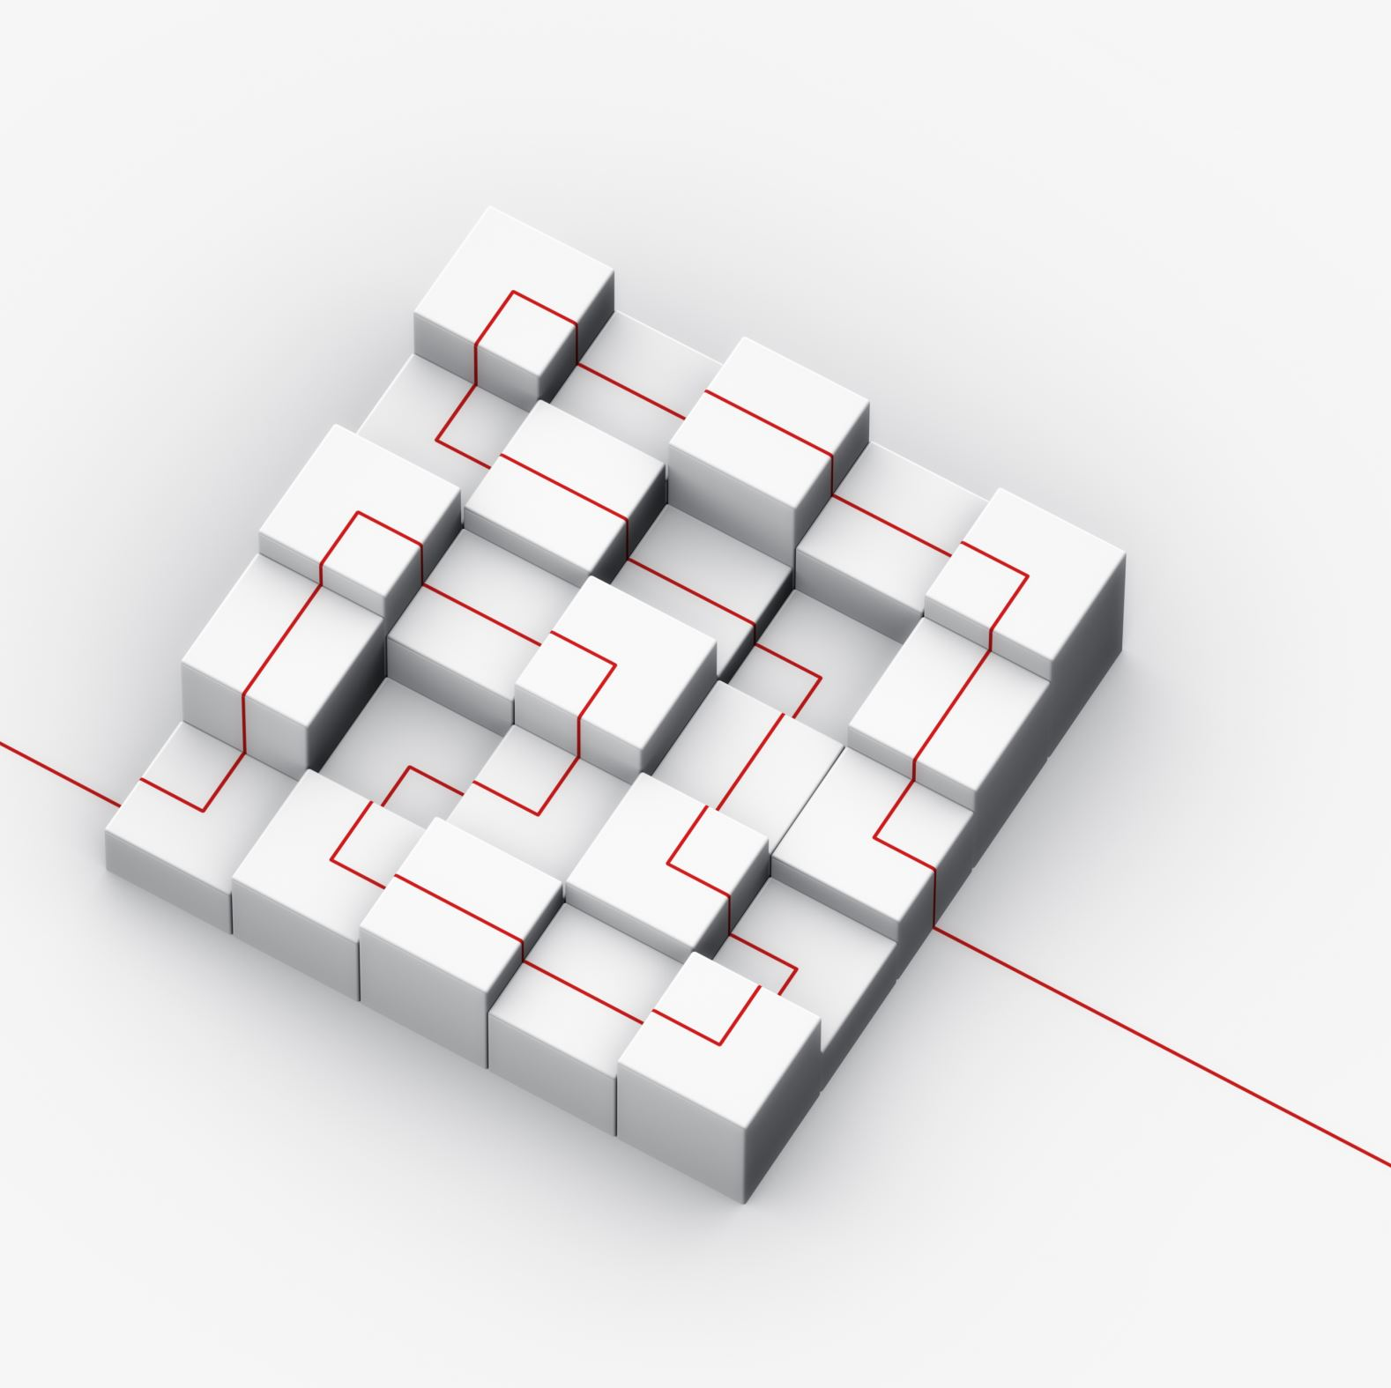
introduction
Architecture Goals
Architecture Design
Demonstration
Challenges/Improvisations

Slide 3
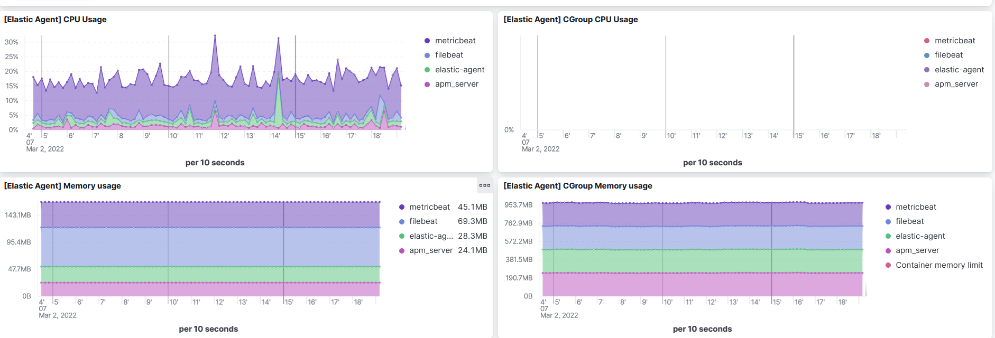
Architecture goals
Continuation of DevOps API
Provide additional Provisioning and Monitoring for Kubernetes cluster
System for alerting operator of when horizontal scaling must be addressed
Further optimizations

Slide 4
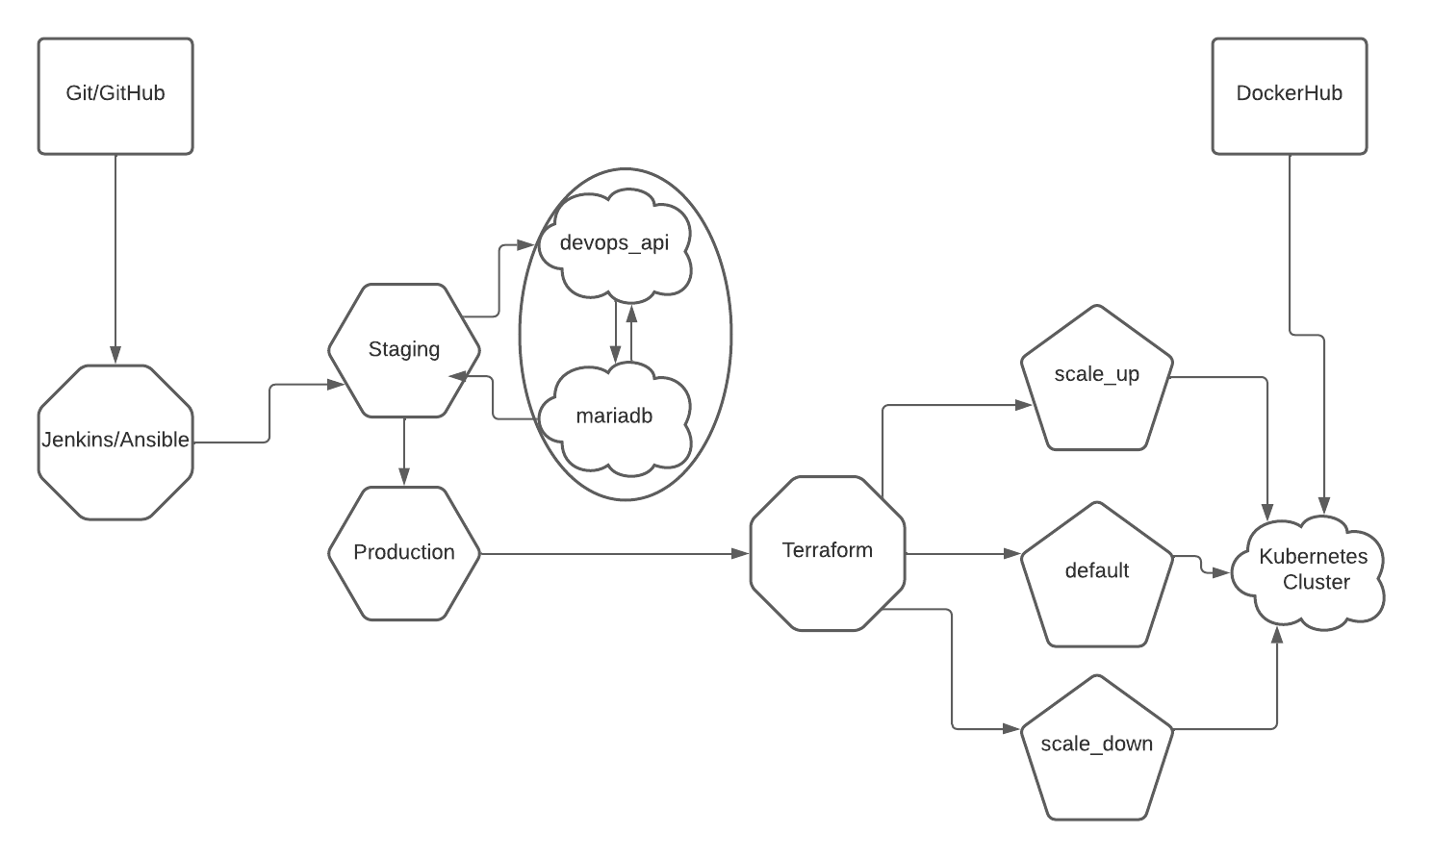
Architecture design

Slide 5
List of resources
Python 3.9 (Flask, marshmallow, mariadb, requests, flake8, pipenv)
Docker/DockerHub
Git/GitHub
Dockerized Jenkins/Ansible
Kubernetes
Terraform
Provisioning Kubernetes Scalability
ELK Stack (Elastic Cloud)
Monitoring System and Cluster Metrics

Slide 6
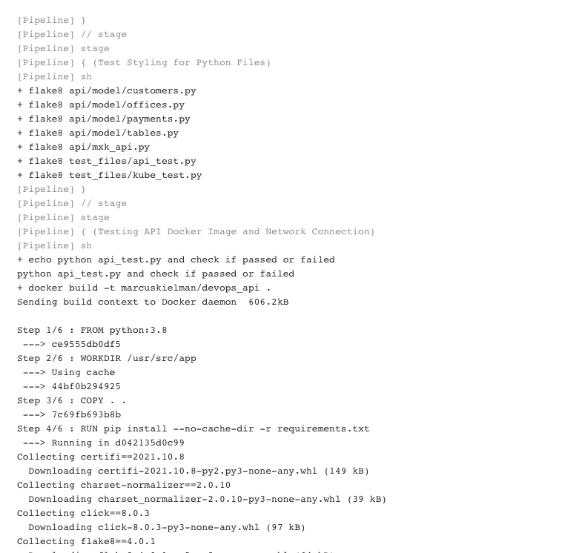
Steps for development
pipenv shell && pip install –r requirements.txt
Can also use pipenv to build docker images
Make changes and test locally
Push to feature repository, merge with Stage, and push Stage

Slide 7
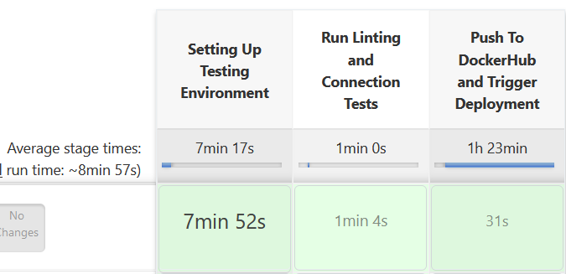
Steps for ci/cd deployment
Changes in main repository trigger a build in Jenkins and pulls from main branch
Jenkins runs env-playbook.yml
Build and run marcuskielman/devops_api image
Run marcuskielman/mariadb and add persistence
Run api_test.py and curl tests
Trigger Ansible to run kube-playbook.yml

Slide 8
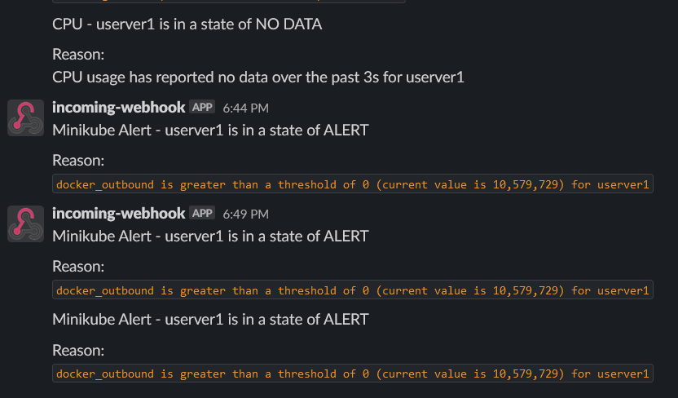
Monitoring
ELK Stack monitors system CPU, Memory, Network
Kubernetes Metrics also monitored through container they run on
Alerts also added so operators can get notice when outbound traffic is too high

Slide 9
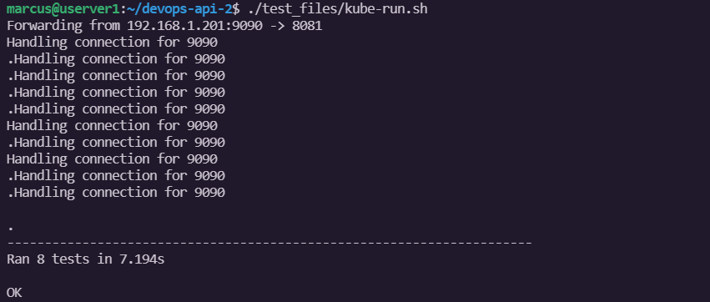
Testing
Using curl
api_test.py for CI/CD or development testing
kube_test.py for Deployment testing

Slide 10
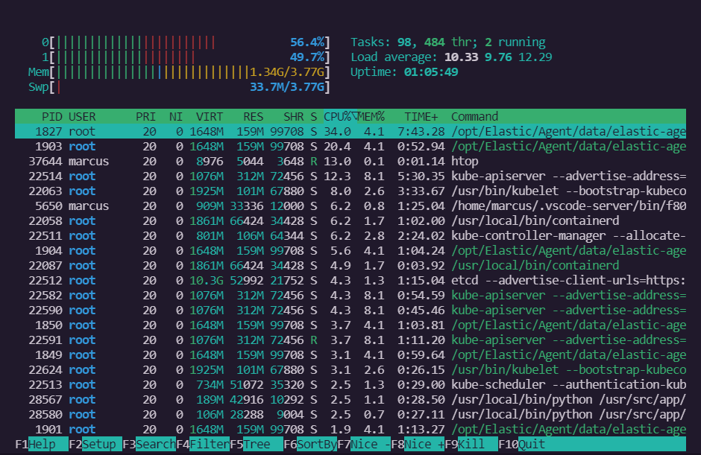
Demonstration

Slide 11
Challenges and improvisations

Slide 12
challenges
Monitoring the Kubernetes Cluster Directly (had to monitor via docker containers)
Providing clean provisioning to replace pods and scale
Providing communication between Ansible and machine

Slide 13

Additional features for future versions
Getting from all tables in database
Modifying Terraform modules for vertical scalability
Deployment on AWS

